Slide 1

WePool
Intra-organization carpool
By: Aviel smolanski & Elior uzan

Slide 2

Literature Review: Carpooling Solutions
"Carpooling in times of crisis"
Employee Retention
By: Lohyd Terrier & Bertrand Audrin
08/07/2022
"Carpooling could be the traffic solution we already have"
Lack of Security
By: Jasmine Reimer
11/09/2019
"אתם לא מדמיינים: הפקקים במרכז החמירו, זו המהירות הממוצעת שהולכת יורדת"
Severe traffic jams
By: דן רבן
09/12/2024

Slide 3






Competitor Analysis: Existing Carpool Apps
 | Waze Carpool | Moovit | BlaBlaCar | Gett | Via
Scope | wide | wide | wide | Wide/ limited | Wide/ limited
Security (derived from the scope) | low | low | low | high | medium
Popularity | closed | closed | Popular among long rides | high | Rapidly growing
Pricing | low | low | low | high | medium

Slide 4

Functional Requirements
User Roles and Permissions
Ride Creation and Booking
Supports 3 user roles with varying permissions.
Allows to create and join rides based on
preferred settings.
Ride Matching
Finds an efficient match between users based on desired arrival\departure time

Slide 5
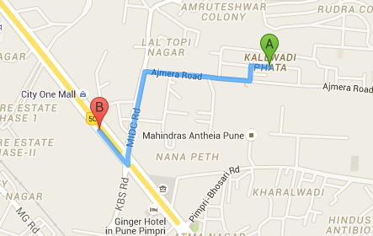
Arrival time: 10: 00
Overhead: 5 minutes
First departure time: 9:00
Max deviation : 10 minutes
Pickup time: 09: 20
Range of change: 9:10 – 9:30
current departure time:
8:55
8:45
Ride Matching
The system matches passengers with drivers based on the following criteria:
For work-bound trips: No more than a 30-minute difference between the driver’s arrival time and the passenger’s desired arrival time.
For home-bound trips: No more than a 30-minute difference between the driver’s start time and the passenger’s desired start time.
The system ensures the specific passenger’s inclusion does not exceed the deviation threshold set by the driver.
Whenever a passenger or rider enters their desired arrival time, the system sets the actual time 10 minutes earlier behind the scenes, to prevent potential delays and unexpected traffic jams.
Wanted arrival time: 10:00
Actual arrival time: 9:50
Arrival time: 10: 00
Overhead: 10 minutes

Slide 6
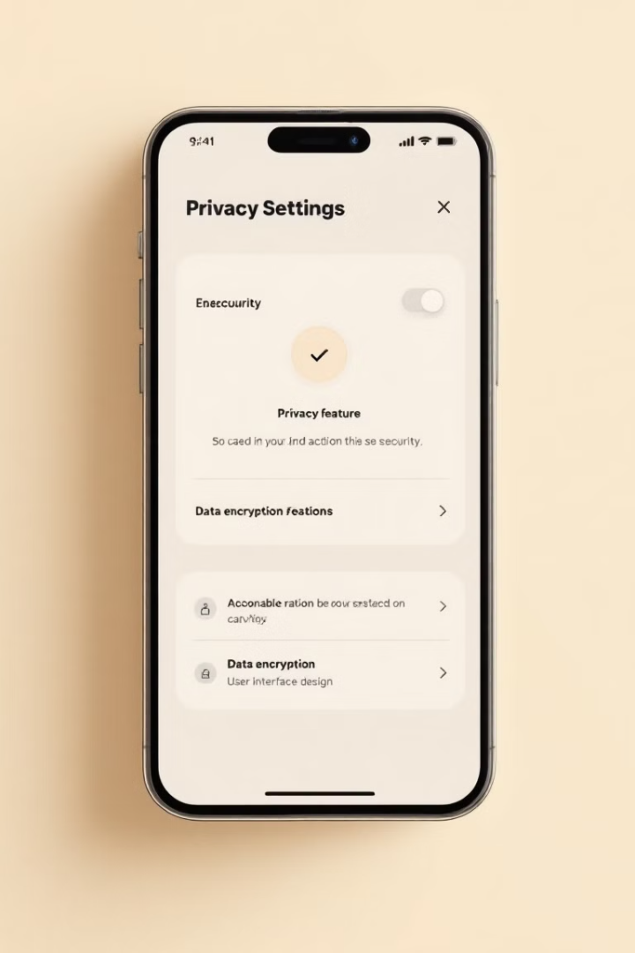




Non-Functional Requirements
Usability
Scalability
The Android app should be intuitive, with a clean and responsive interface.
The system should support the addition of new organizations without significant reconfiguration.
It must scale to accommodate increasing users within an organization
Performance
Availability
Handles up to 10,000 users simultaneously
Ride matching queries should complete up to 2 second in 95% of cases.
The system must be available 99.9% of the time, with scheduled maintenance during off-peak hours.

Slide 7





Detailed Design: Architecture
Android Studio
Eclipse customized with Spring Boot Tool
REST API
user
Server-Side Backend
Mobile app
PostgreSQL
Waze/Google Maps API
Data Base

Slide 8
USER
Detailed Design: Class Diagram
UserId
Name
Email
Password
comapnyID
isBanned
RideHistory
Login()
Logout()
hasPermission()
CancelRide()
DRIVER
PASSENGER
HR_MANAGER
AvailableSeats
vheicleDetails
PreferredPickUpLocation
MaxBadPoints
0..4
SearchRide()
JoinRide()
setPolicyParameters()
manageUsers()
viewCompanyStatistics()
addWorkers()
removeWorkers()
AcceptPassengerRequest()
StartRide()
CreateRide()
0..1
--------------------
ManagesCompany
1
RIDE
Date
---------------
ADMIN
Companies
1
alterSettings()
viewCompanySettings()
SETTINGS
COMPANY
KEY
VALUE
companyID
companyName
Settings
workers
1..2
+
has
1
getValue()
setValue()
*
displayWoekers()

Slide 9
